Slide 1

NIT WARANGAL
DBMS PROJECT
FACULTY : DR.RAMAKRISHNUDU
DR.RBV
SUBRAMANYAM
TEAM :
21CSB0B07 B BHARADWAJ
21CSB0B62 U ASHISH
KUMAR

Slide 2

PROBLEM STATEMENT
MALL MANAGEMENT DATABASE SYSTEM
Shopping malls are fast becoming a central part of life all over the world.
Many malls are being constructed in all developing countries. However,
maintenance of malls is an important necessity. So, we have designed a
database to store information about Mall.
Through this database system we can manage maintenance of all the shops
and other places in a particular mall and also monitor all activities of all
Mall. Also, it enables the administrator to get information about expenses
and earnings of all the shops in a Mall which gets updated each time after
installment of any new activity with less time and less effort.
Presentation title
2

Slide 3
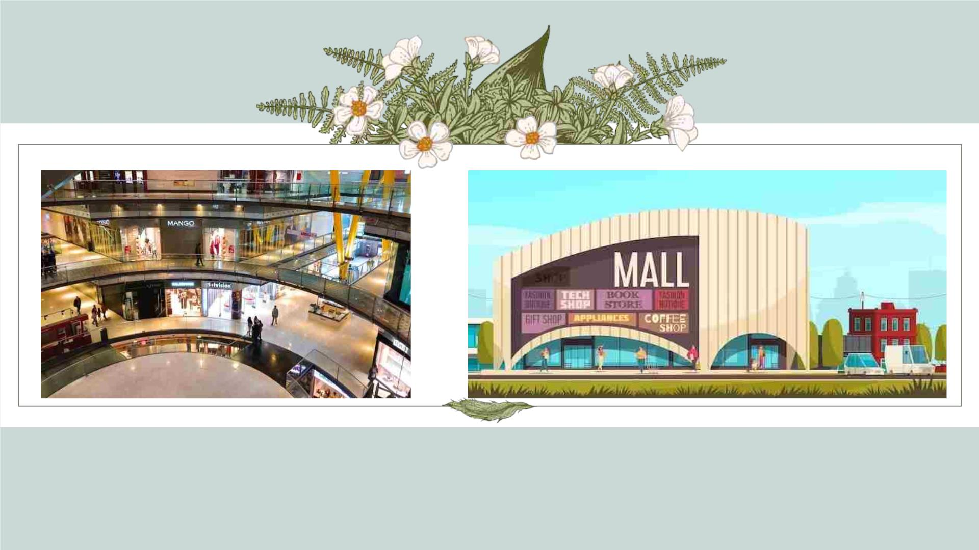

Slide 4
CONTENTS
Ø ER Diagram
Ø Assumptions
Ø Normalized Tables
Ø Relational Schema after normalization
Ø Queries and Output
Presentation title
4

Slide 5
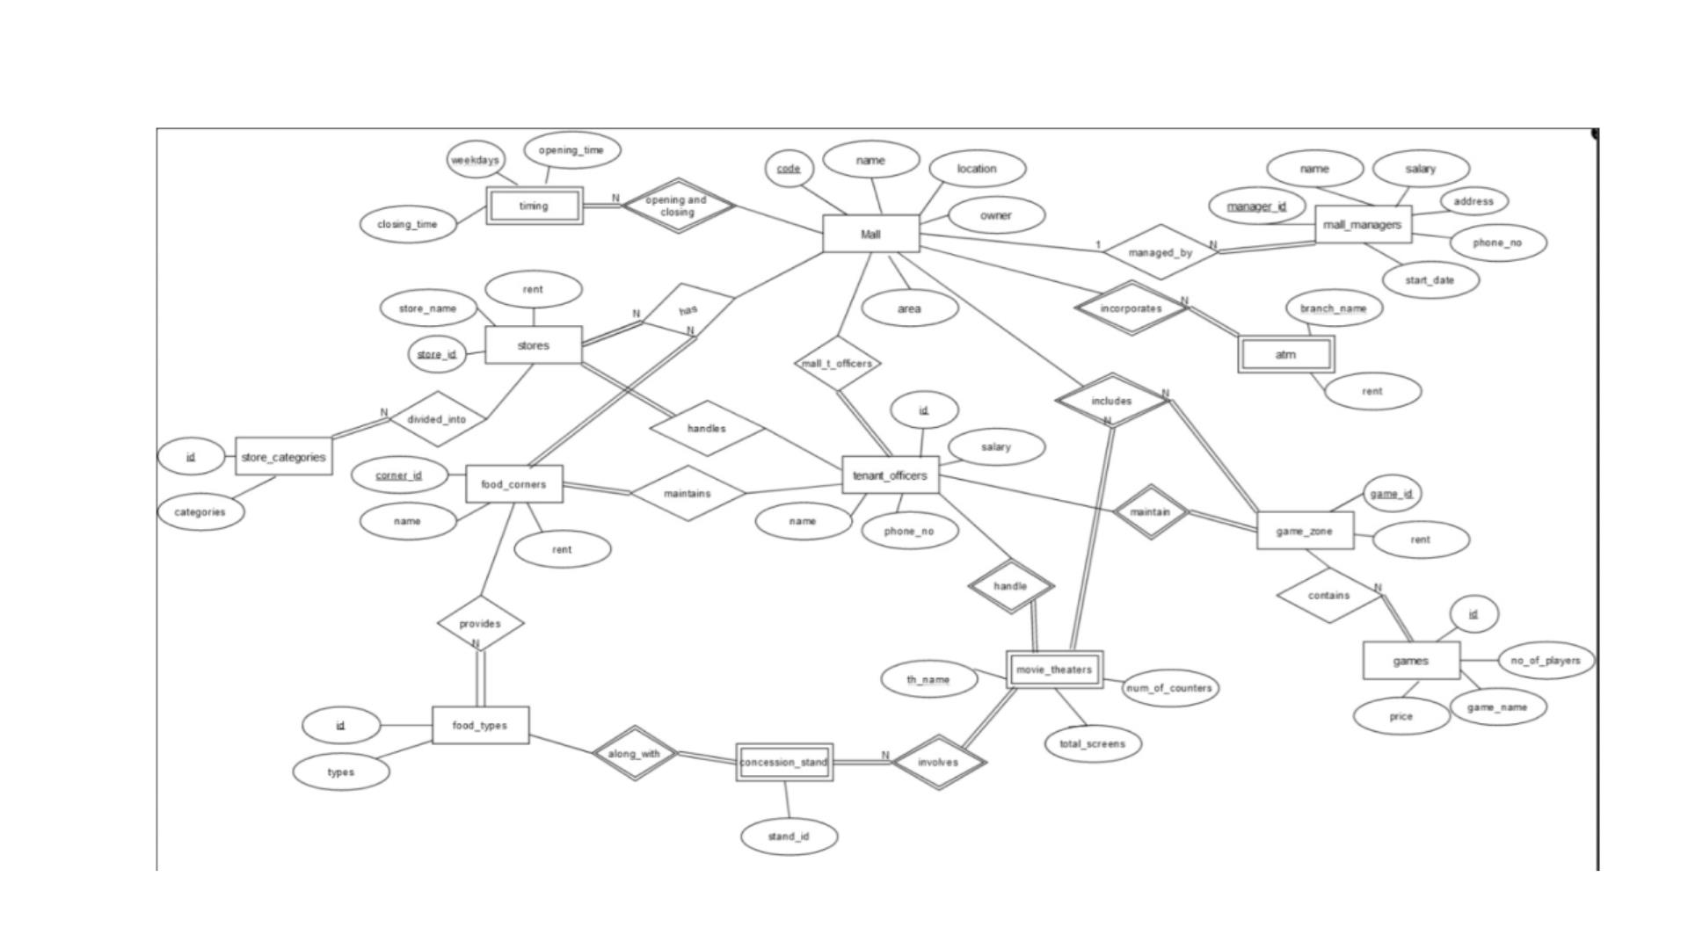
ER DIAGRAM
Presentation title
5

Slide 6
ASSUMPTIONS
1) Each mall has at least one Tenant Officer, and each tenant officer is
employed in at least one of the given malls, therefore there is total
participation and many to many relationship between mall and
tenant_officers. Mall has area with unit sq.ft.
2) In mall managers relation, each manager is employed in at least one of
the malls, So there is total participation of Mall_managers.
3) Timing relation is a weak entity set having weekdays as its partial key.
Presentation title
6

Slide 7
ASSUMPTIONS
4) Food_Types and Store_Categories & Games relations store information
about the types of food corners like restaurants, ice-cream parlour etc., and
clothing, pharamacy etc. and different game names respectively along with
its ID to identify the type.
5) Stores and Food_Corners have different IDs(Primary key) for different
malls. Also, each mall has no, one or more than one stores, and each store is
present in one mall, so there is a one to many relationship with total
participation of stores.Same is in the case of Food Corners relation. Rent
given is per month.
Presentation title
7

Slide 8
ASSUMPTIONS
6) Game Zone is a weak entity set with GameID as its partial key, which
is also a foreign key from Games table. It is assumed that No. of players
in the games table are not exact, there can be less no of players. Price
of games are given by per player.
7) Movie Theatres is a weak entity set with Th_name as its partial key.
It is assumed that each mall has only one theatre with many screens, so
the relationship is one to one type.
Presentation title
8

Slide 9
ASSUMPTIONS
8) Concession Stand is a weak entity set with standId as its primary key,
and it is also connected to the food_types relation with typeID as
foreign key which determines the type of stand inside movie theatres.
Each theatre in a particular mall can have one or more than one stand
and each stand is present in only one mall, so the relationship is one to
many type.
9) ATM is a weak entity set with branch_name as its partial key. Each
mall has more than one ATM, so it is one to many relationship type.
Presentation title
9

Slide 10
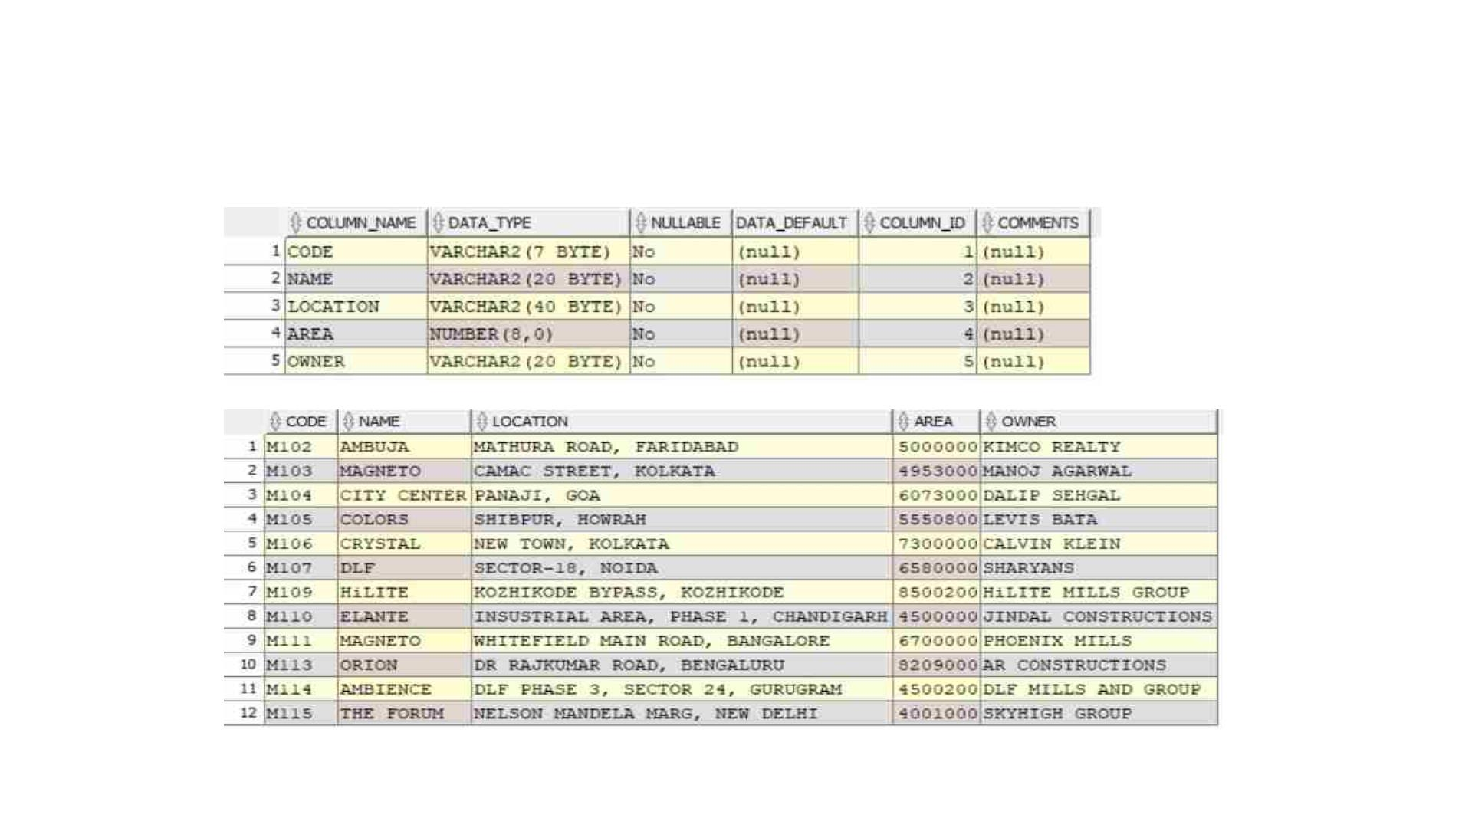
NORMALISED TABLES
1)Mall
Presentation title
10

Slide 11
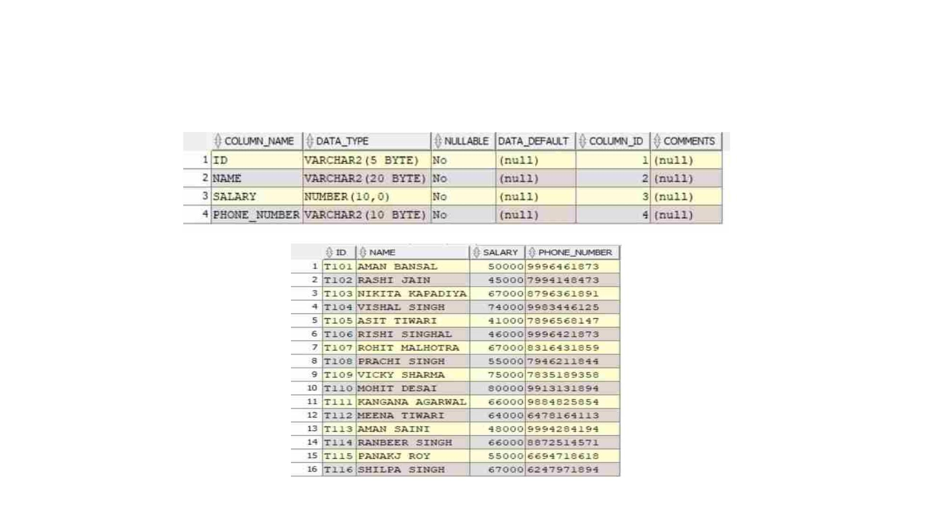
NORMALISED TABLES
2)Tenent_officers
Presentation title
11

Slide 12
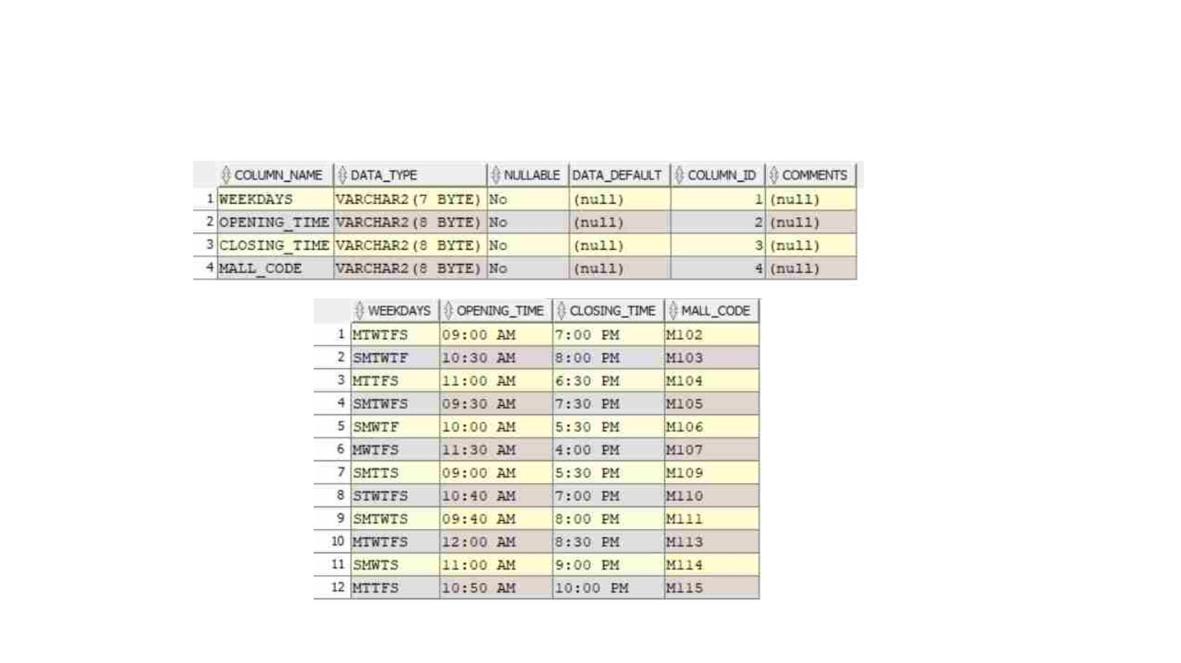
NORMALISED TABLES
3)Timings
Presentation title
12

Slide 13
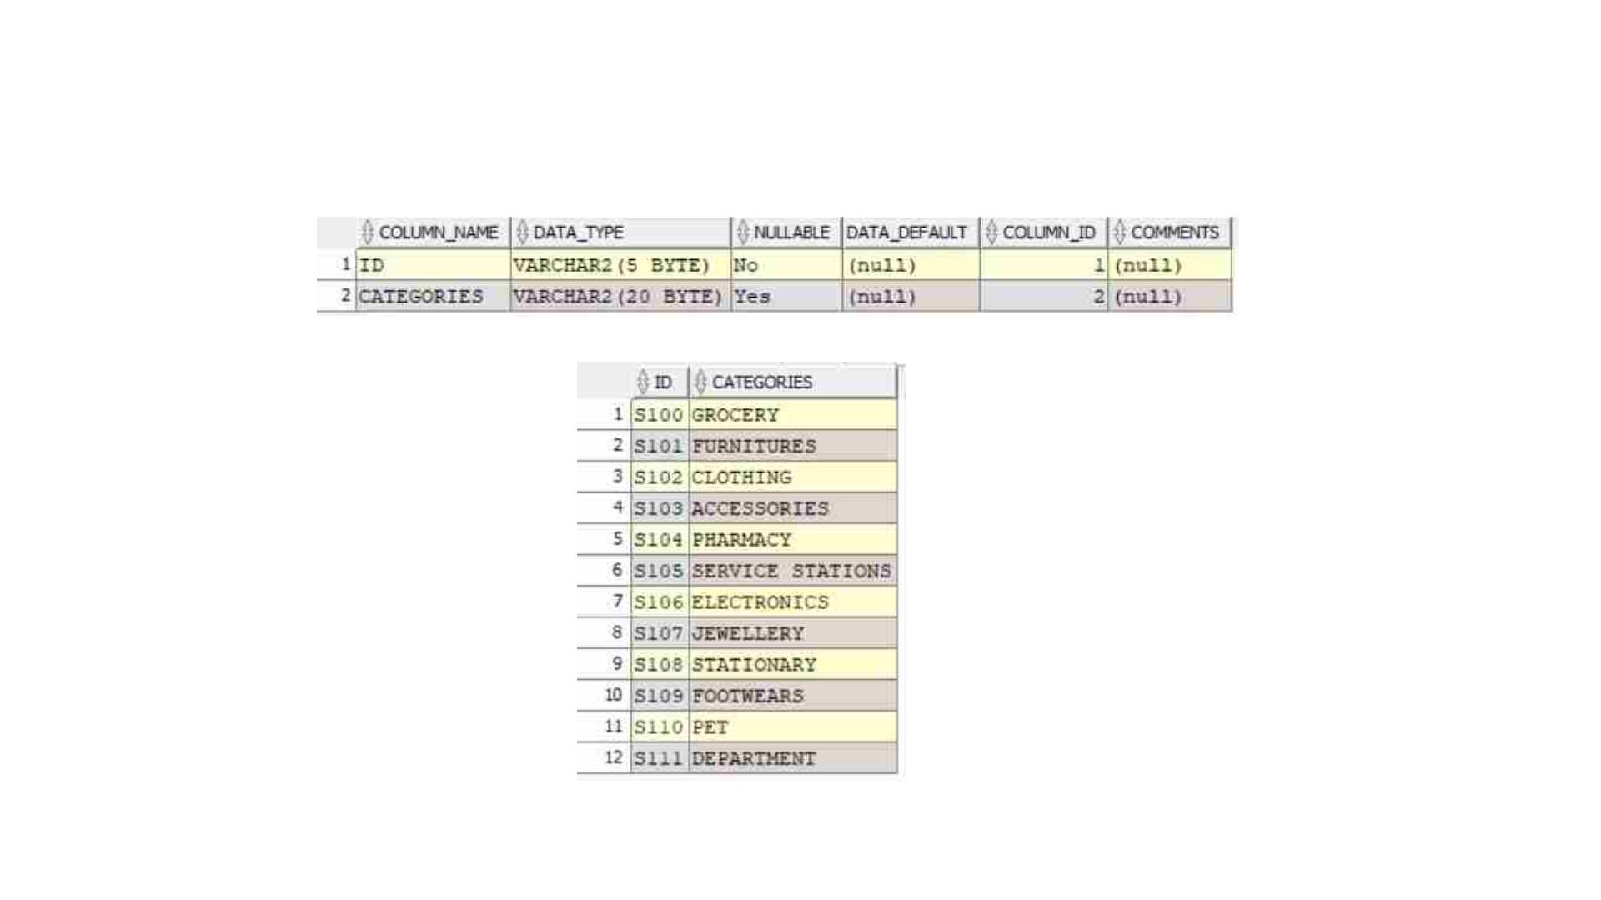
NORMALISED TABLES
4)Store_categories
Presentation title
13

Slide 14
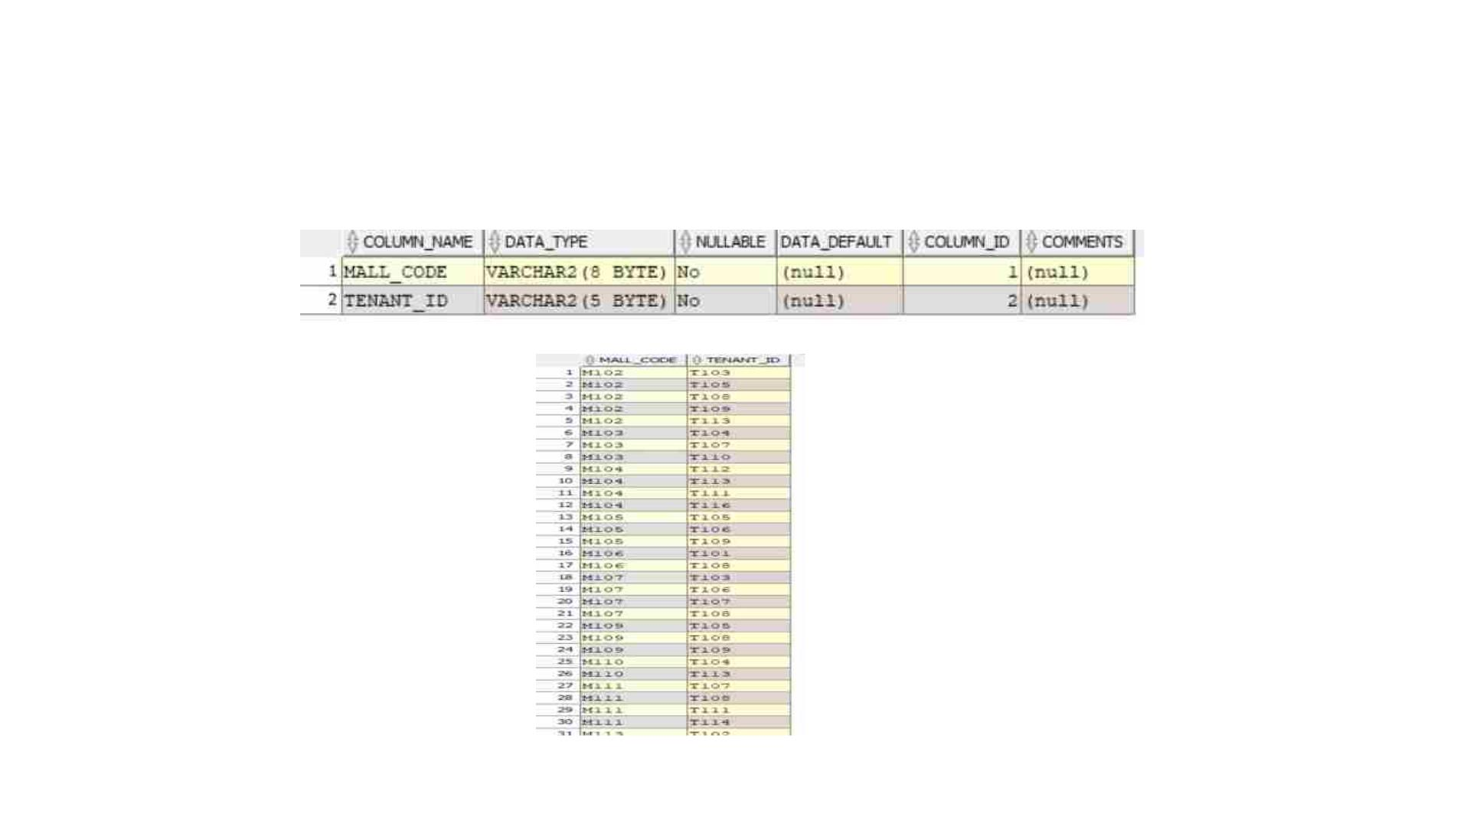
NORMALISED TABLES
5)Mall_tenant_officers
Presentation title
14

Slide 15
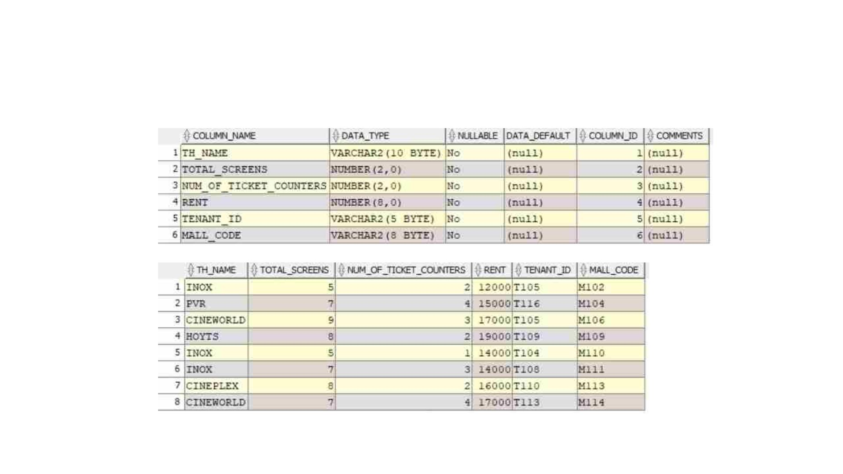
NORMALISED TABLES
6)Movie_theatres
Presentation title
15

Slide 16
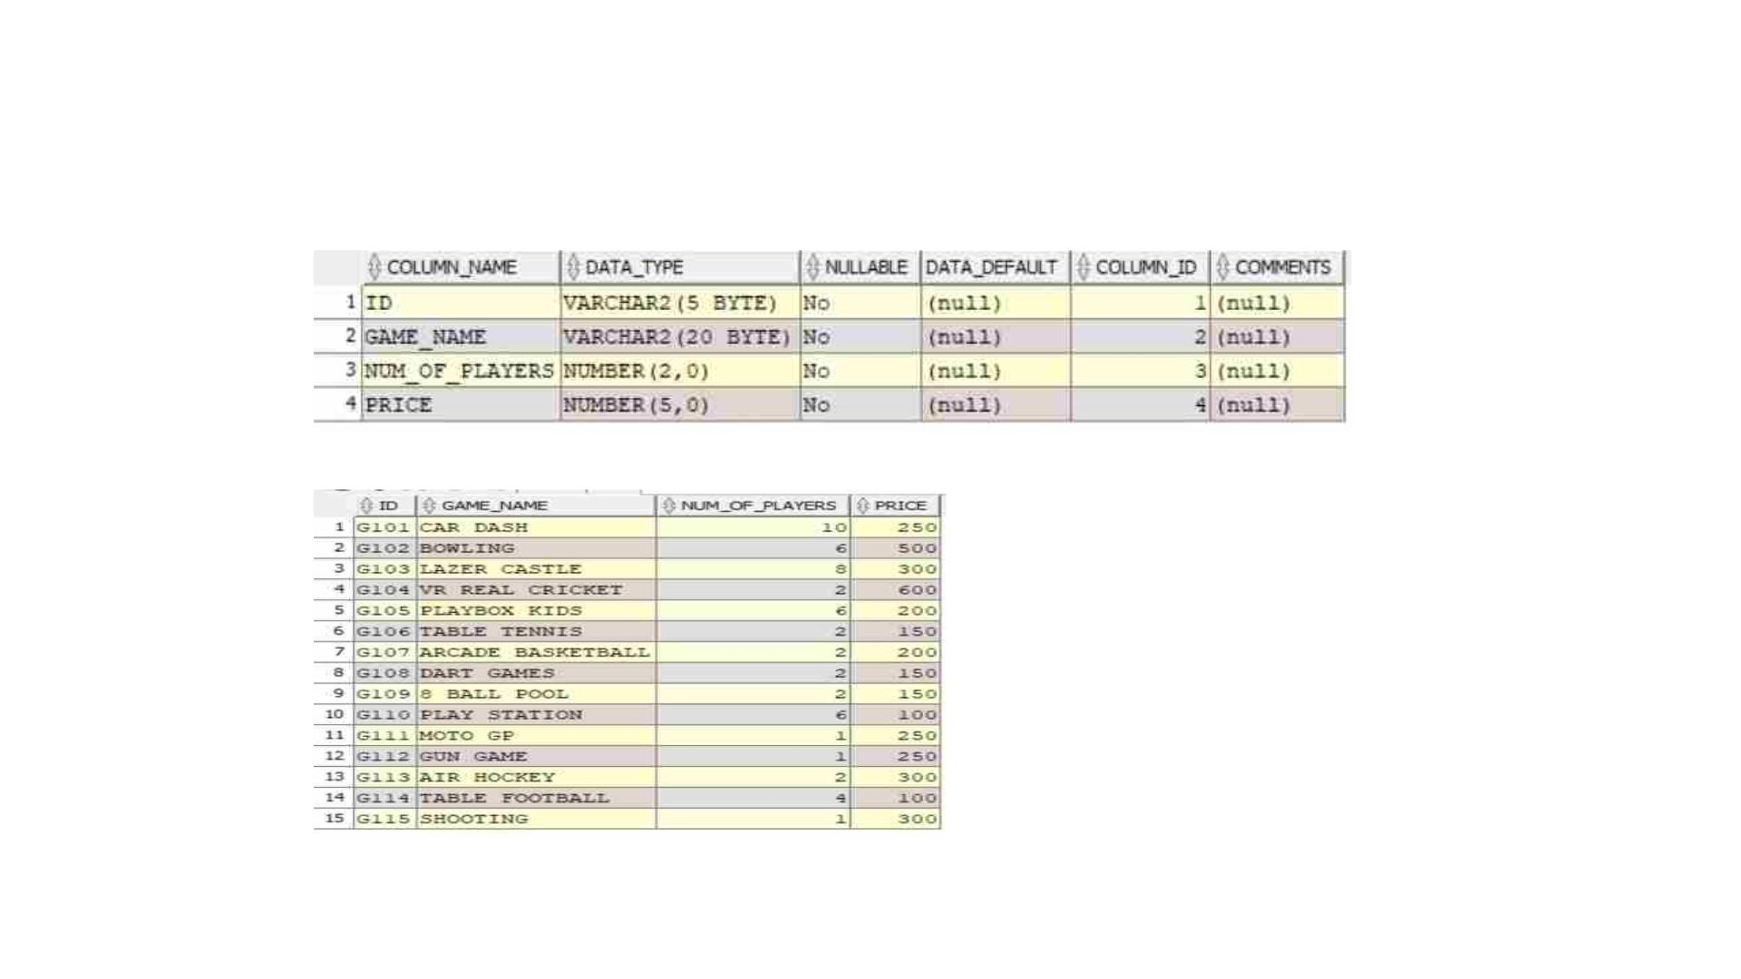
NORMALISED TABLES
7)Games
Presentation title
16

Slide 17
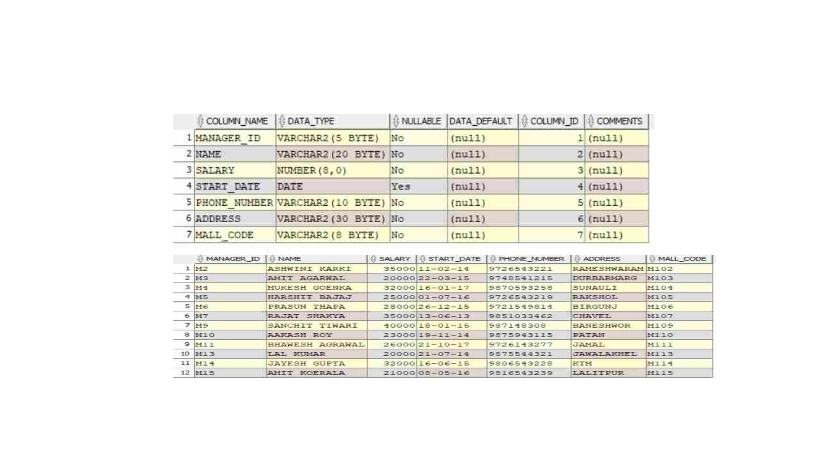
NORMALISED TABLES
8)Mall_managers
Presentation title
17

Slide 18
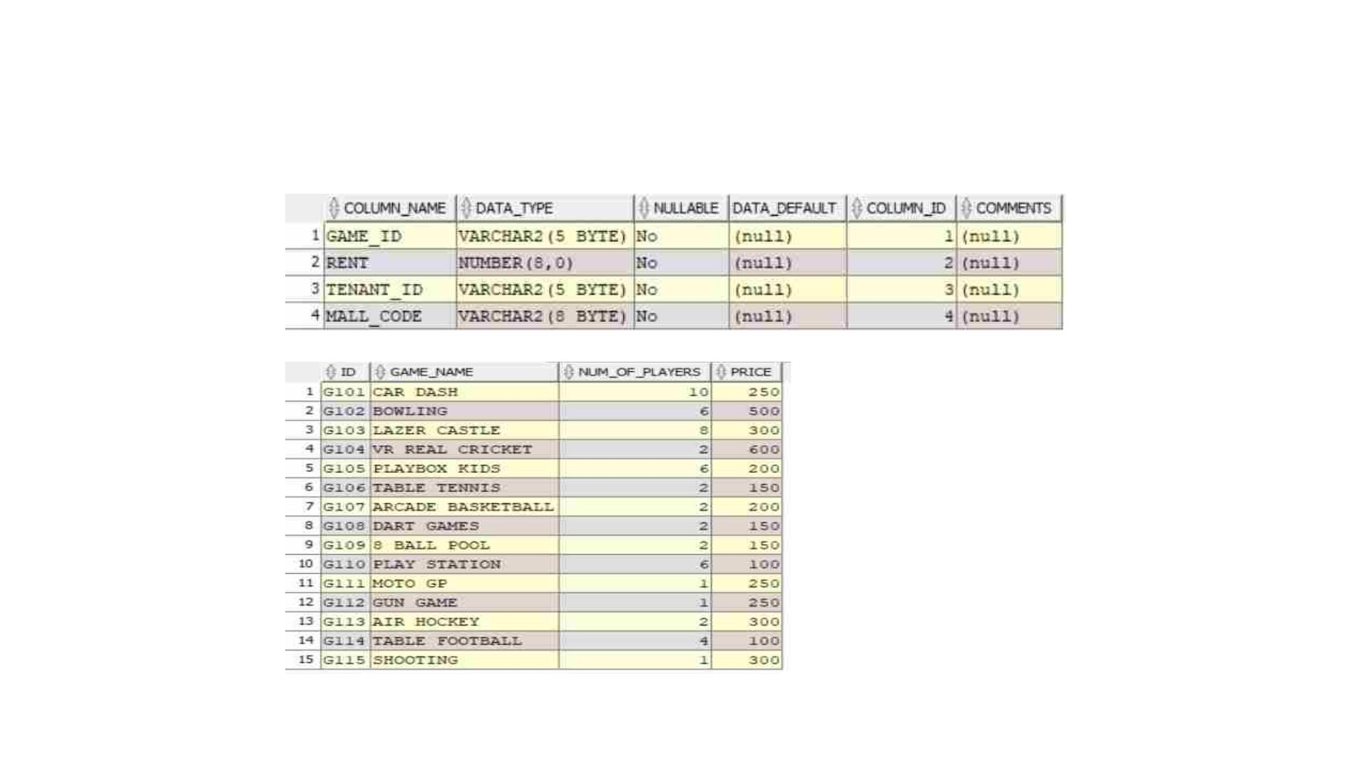
NORMALISED TABLES
9)Game_zone
Presentation title
18

Slide 19
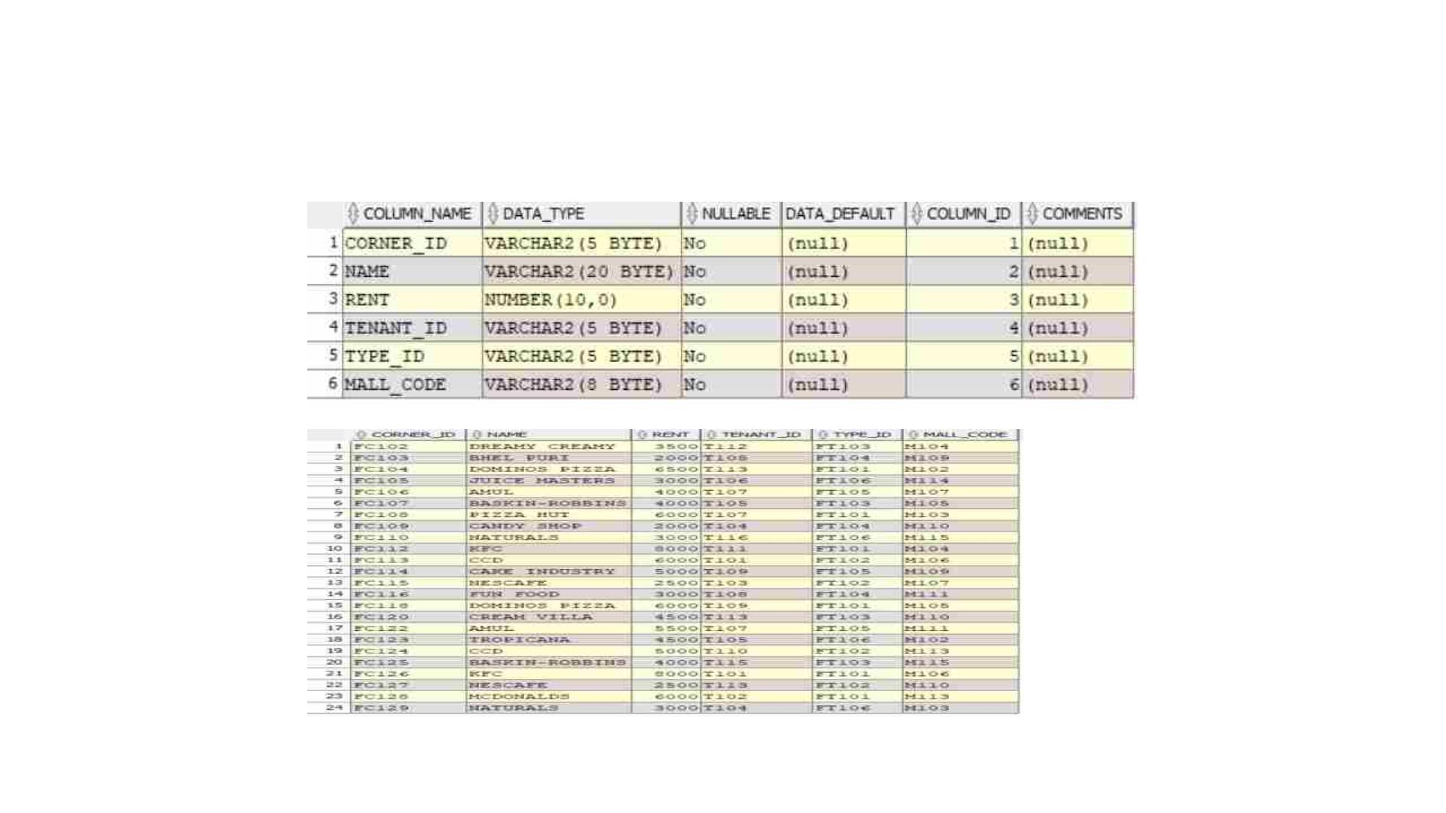
NORMALISED TABLES
10)Food_corners
Presentation title
19

Slide 20
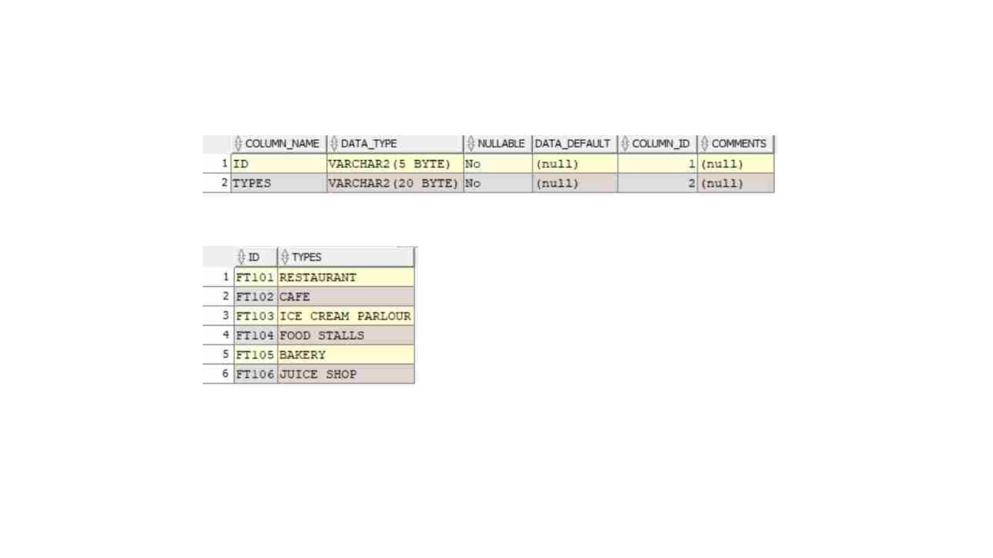
NORMALISED TABLES
11)Food_types
Presentation title
20

Slide 21
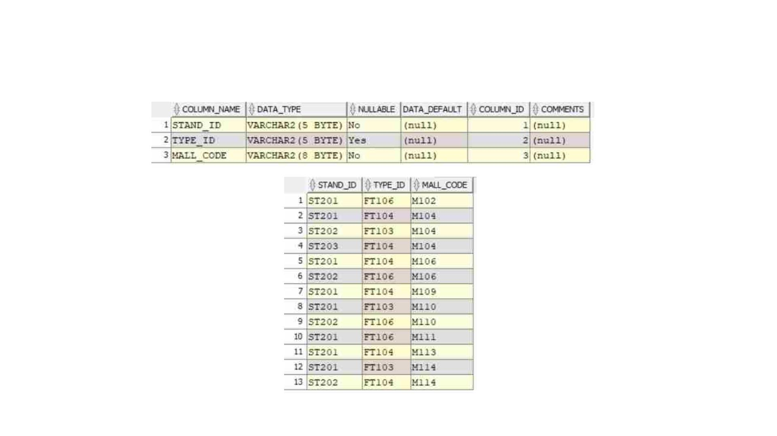
NORMALISED TABLES
12)Concession_stand
Presentation title
21

Slide 22
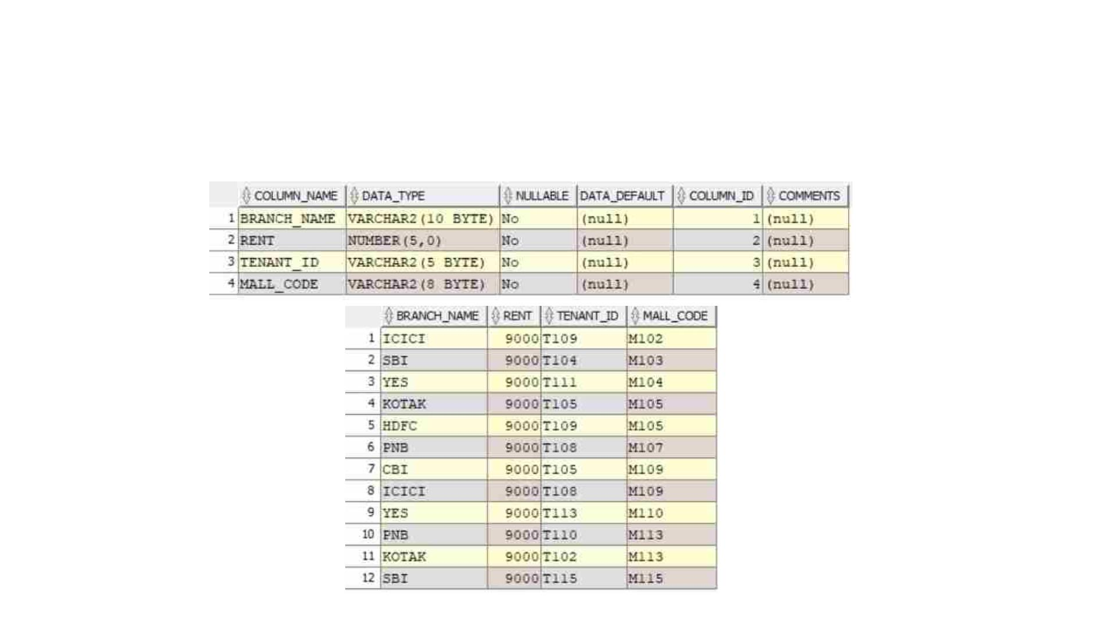
NORMALISED TABLES
13)ATM
Presentation title
22

Slide 23
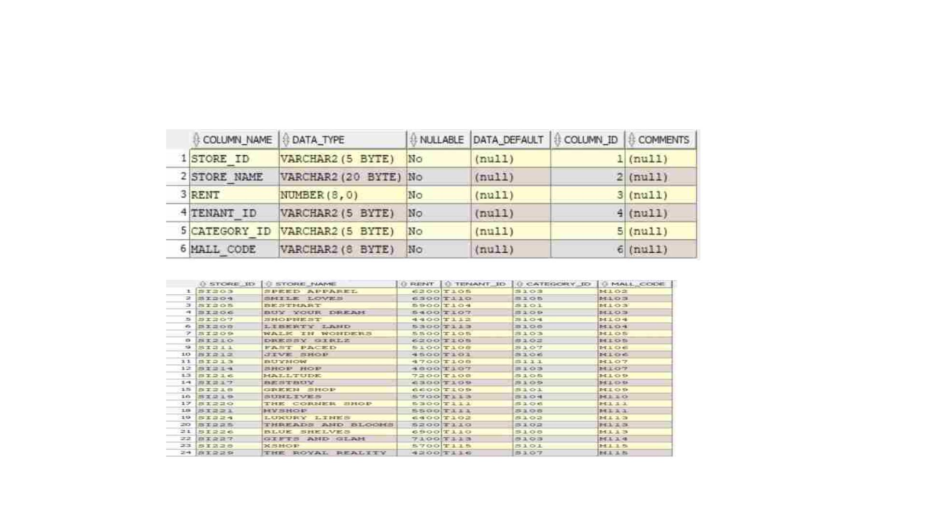
NORMALISED TABLES
14)Stores
Presentation title
23

Slide 24
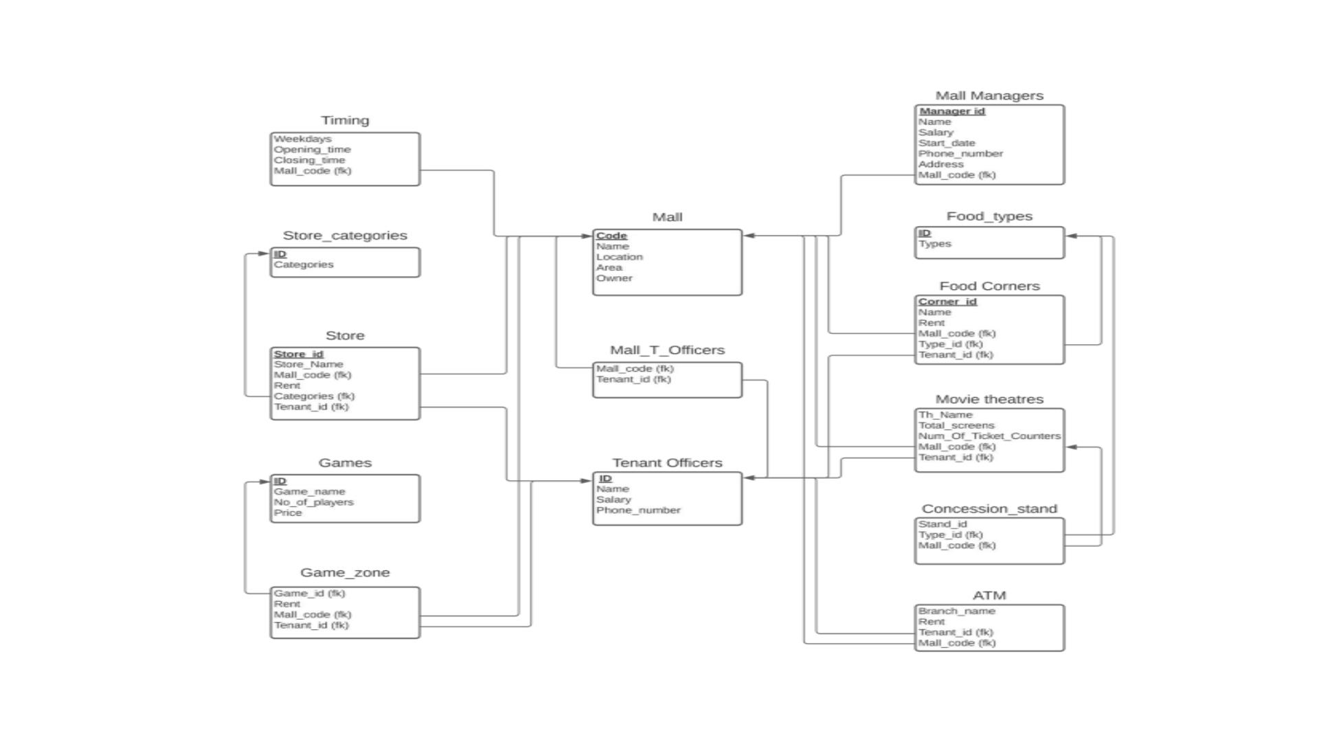
RELATIONAL SCHEMA AFTER NORMALISATION
Presentation title
24

Slide 25
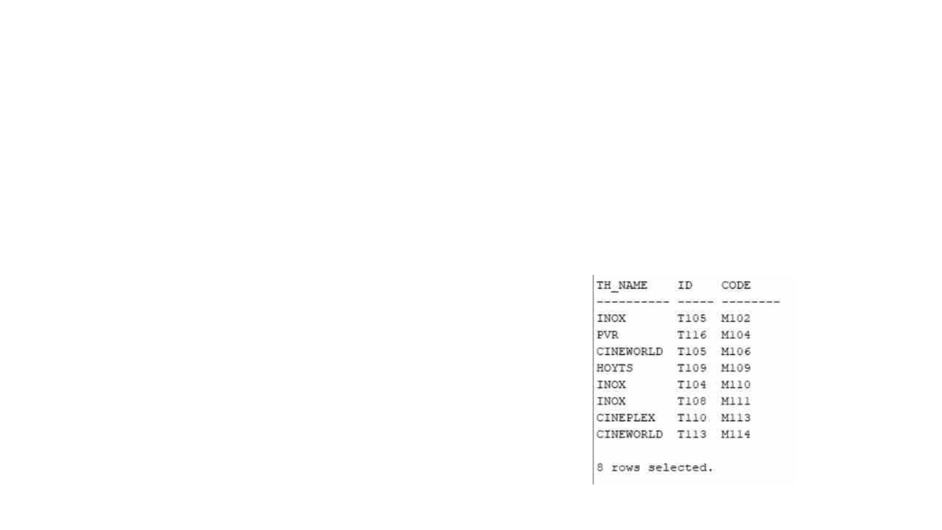
QUERIES
1)Retrieve the details of movie theaters along with their associated
tenant officers and mall details
Query:
SELECT MT., TO.*, M.FROM MOVIE_THEATRES MTJOIN
TENANT_OFFICERS TO ON MT.TENANT_ID = TO.IDJOIN MALL M ON
MT.MALL_CODE = M.CODE;
Presentation title
25

Slide 26
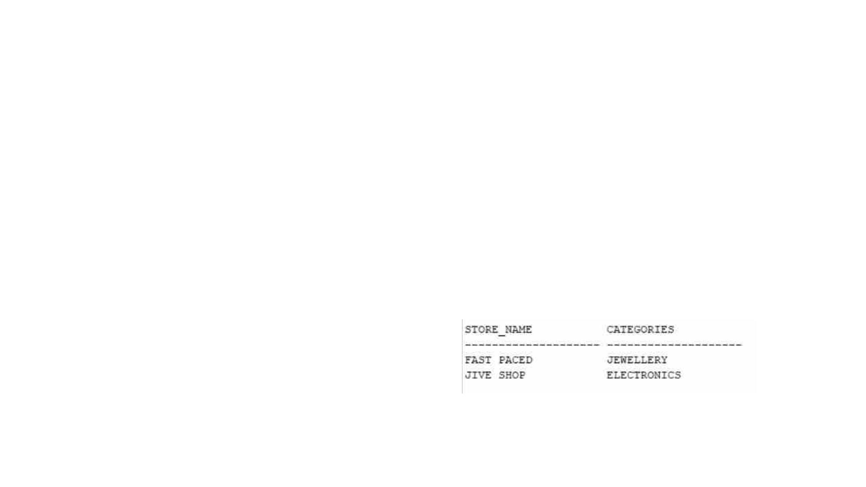
QUERIES
2)Retrieve the details of all stores in a specific mall along with their
corresponding category
Query:
SELECT S.store_name, SC.CATEGORIESFROM STORES SJOIN
STORE_CATEGORIES SC ON S.CATEGORY_ID = SC.IDWHERE
S.MALL_CODE = 'M106’;
Presentation title
26

Slide 27
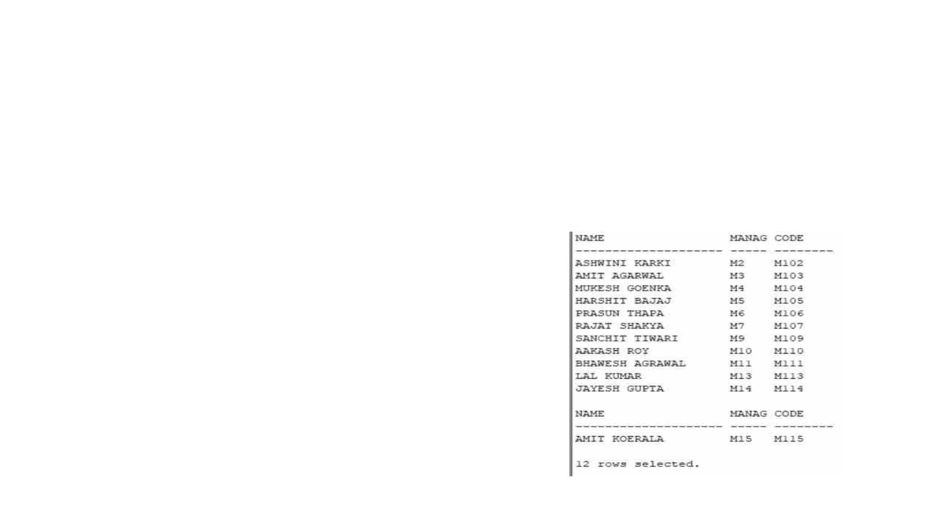
QUERIES
3)Retrieve the details of all mall managers along with their
corresponding mall details
Query:
SELECT MM."NAME",MM.MANAGER_ID, M.CODEFROM
MALL_MANAGERS MMJOIN MALL M ON MM.MALL_CODE = M.CODE;
Presentation title
27

Slide 28
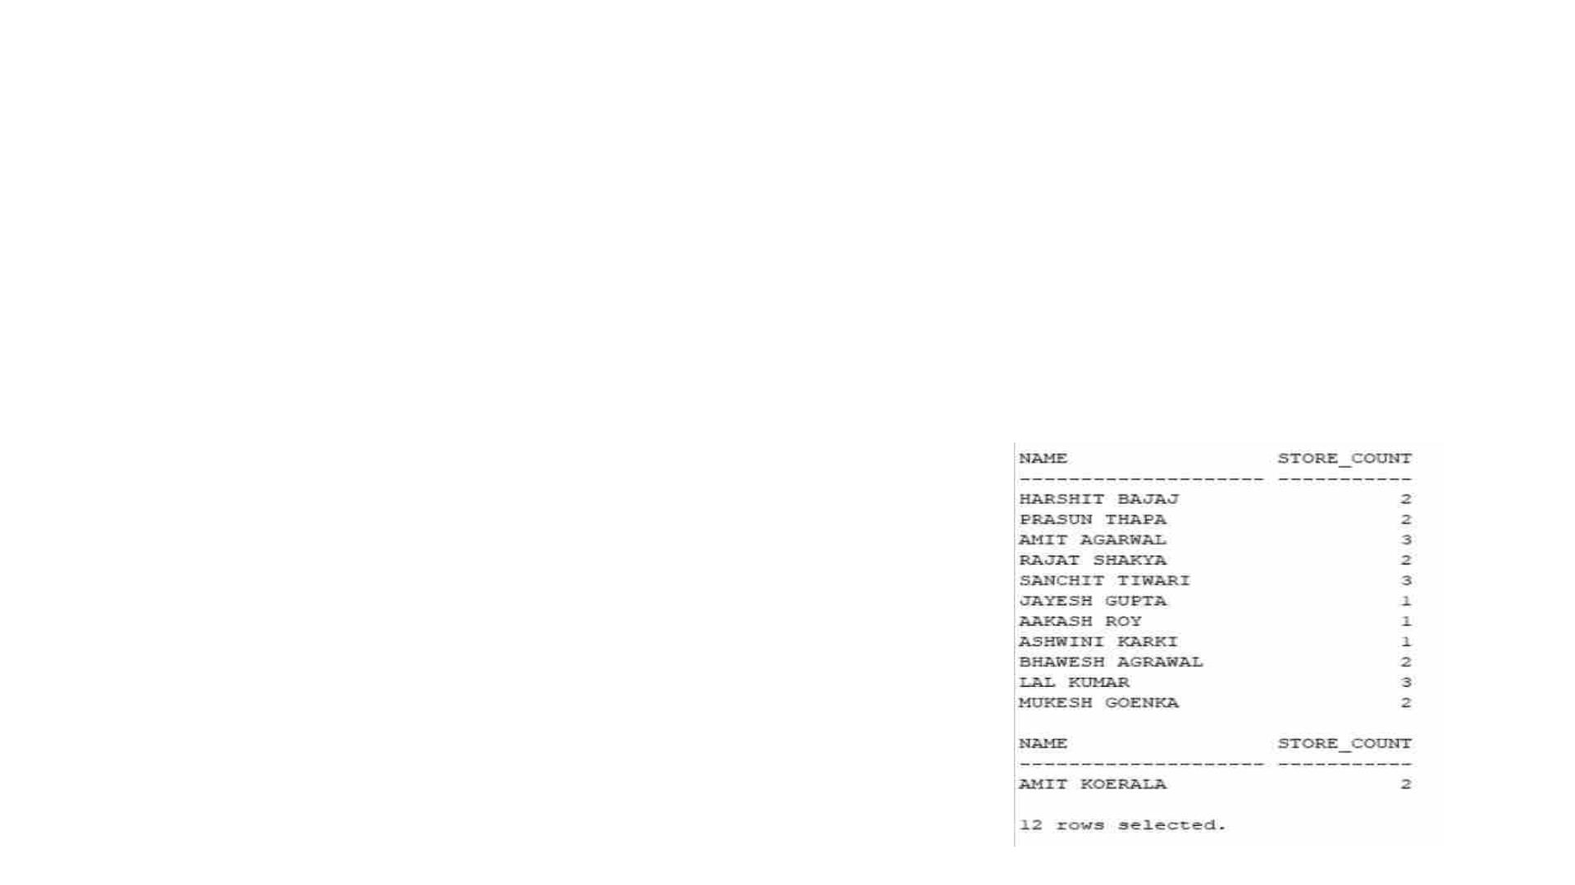
QUERIES
4)Retrieve the names of all mall managers along with the count of
stores they manage
Query:
SELECT MM.NAME, COUNT(S.STORE_ID) AS STORE_COUNTFROM
MALL_MANAGERS MMLEFT JOIN MALL M ON MM.MALL_CODE =
M.CODELEFT JOIN STORES S ON M.CODE =
S.MALL_CODEGROUP BY MM.NAME;
Presentation title
28

Slide 29
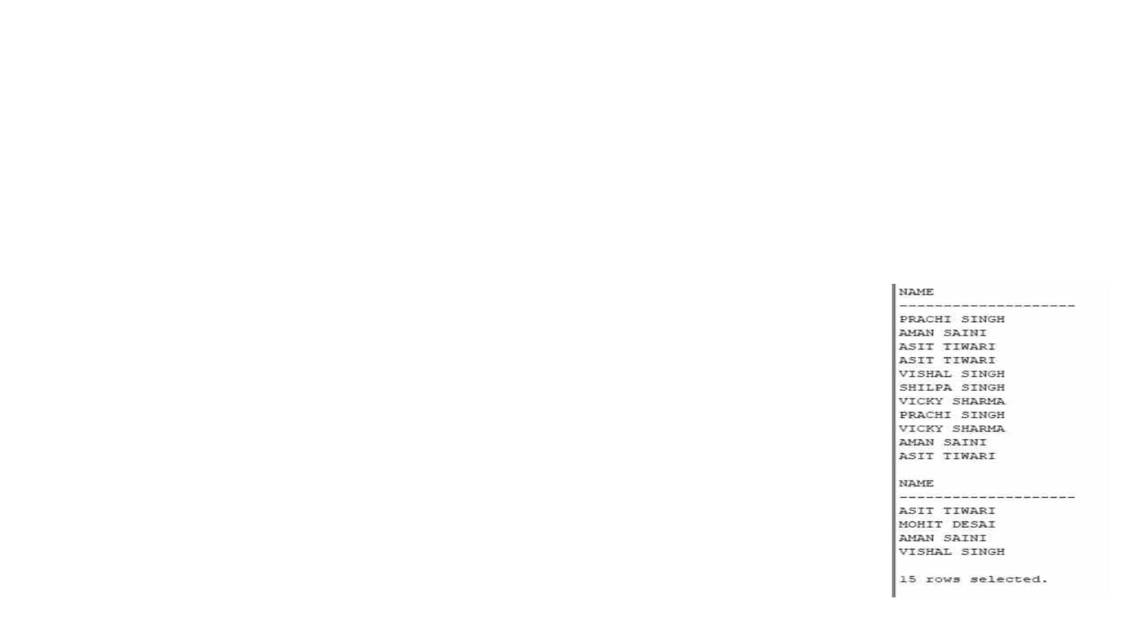
QUERIES
5)Retrieve the names of tenant officers who work in both food
corners and movie theaters
Query:
SELECT TOF."NAME"FROM TENANT_OFFICERS TOFJOIN
FOOD_CORNERS FC ON TOF."ID" = FC.TENANT_IDJOIN
MOVIE_THEATRES MT ON TOF."ID" = MT.TENANT_ID;
Presentation title
29

Slide 30
Summary
This project involves defining primary & foreign keys, establishing
relationships between entities and enforcing constraints. It also
includes complex queries containing advanced SQL operations such as
aggregators, sub-queries, and joins of different kinds. This queries can
be used to obtain many more details regarding the malls. It can
effectively manage the various entities, relationships and operations
within a mall environment. It provides a solid foundation for storing,
organizing and retrieving data related to malls.
Presentation title
30

Slide 31

21CSB0B07 B BHARADWAJ
Thank you
21CSB0B62 U ASHISH KUMAR

